Slide 1
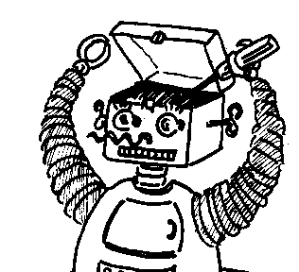
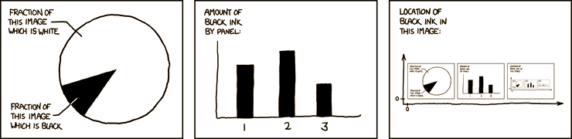

Maryland Metacognition Seminar
http://xkcd.com/
Metacognition for Effective Deliberation in Artificial Agents
Darsana Josyula
Bowie State University, Bowie, MD
18 November 2011, 10:15 PM
A. V. Williams Bldg., Rm. 3258, College Park
Abstract:
Agents that operate in the real world have to make decisions on how long they can deliberate before they act. If the agent deliberates for too long, the agent may miss a deadline or the environment may change such that the preconditions for acting may no longer hold true. If the agent acts too quickly without proper deliberation, it may miss opportunities or may even perform the wrong action. Artiﬁcial agents with a metacognitive ability to monitor and influence deliberation and action can potentially make intelligent decisions regarding when to stop deliberating and start acting. In this talk, I consider 6 different components that influence the metacognitive process: goals; emotions; plans; resource constraints; influence of other agents; and performance optimization. This research is influenced by ancient Vedic schools of thought and evidence from psychological studies that suggests the role of these six components in the cognitive activities of humans.

